Slide 1
Continuous Delivery with Dynatrace Demo Environment
Martin Etmajer
martin.etmajer@dynatrace.com
Senior Technology Strategist @ Dynatrace

Slide 2



Martin Etmajer
Senior Technology Strategist @ Dynatrace
martin.etmajer@dynatrace.com
@metmajer

Slide 3

Wolfgang Gottesheim
Senior Technology Strategist @ Dynatrace
wolfgang.gottesheim@dynatrace.com
@gottesheim

Slide 4
Preparations

Slide 5
Training Environment
Dynatrace 6
Continuous Delivery
Demo Environment

SSH, dynaTrace Client

Slide 6
Attendees need to bring...
Hardware
Laptop
Installed Software
SSH Client (ssh, Putty, Bitvise SSH Client,..)
dynaTrace Client (or Java7 for the Dynatrace WebStart Client)

Slide 7
Attendees need to be given...
Credentials (when using a local VirtualBox or VMware instance)
User / Password: dynatrace / dynatrace
SSH Private Key (when accessing a remote instance via SSH)
OpenSSH (for those who use ssh on the command line) Example: ssh –i dynatrace dynatrace@$IP
Putty (OpenSSH keys need to be converted using PuTTYgen)
The user dynatrace can achieve superuser permissions via sudo. Example: open a root shell via `sudo bash`.

Slide 8
Training Environment

Slide 9
Training Environment
Available as Virtual Machines for various Platforms:
VirtualBox, VMware
Amazon EC2 (AMI + EBS-Backed Instance)

Slide 10






Environment Overview
Apache
Apache Tomcat
Apache Tomcat
Apache Derby




Web Server
Frontend
Application Server
Backend
Application Server
Database
Git
Jenkins


check out
deploy
VCS
Build Automation
Dynatrace
unit tests

Slide 11



What gets deployed?
Apache
Apache Tomcat
Apache Derby
✔
✔
✔
Web Server
Application Server
Database

Config
Agent
Config
Binaries
Agent
Data

Slide 12
Relevant Paths: User dynatrace
Path | Description
/home/dynatrace | Dynatrace user’s home directory
/home/dynatrace/easytravel-deploy-playbook | Reference Ansible Playbook for automated deployments of easyTravel Customer Frontend and Business Backend (meant to acts as a reference if the deploy playbooks in /opt/git were stripped down for the purpose of a training).
/home/dynatrace/easytravel-deploy-playbook/pipeline.sh | Standalone sample CD deployment pipeline implementation for easyTravel in bash

Slide 13
Relevant Paths: easyTravel
Path | Description
/opt/git/easytravel | easyTravel source code repository (to be checked out and built by Jenkins)
/opt/git/easytravel/Distribution/build.xml | easyTravel Ant build script
/opt/git/easytravel/TravelTest/build.xml | easyTravel Ant build script for running tests Example: `ant -Dtestpattern=frontend/**/*Test` Example: `ant -Dtestpattern=business/**/*Test`
/opt/git/easytravel-deploy-business-backend | easyTravel BusinessBackend deployment scripts (to be run by Jenkins)
/opt/git/easytravel-deploy-customer-frontend | easyTravel CustomerFrontend deployment scripts (to be run by Jenkins)

Slide 14
Relevant Paths: Dependencies
Path | Description
/opt/db-derby | Derby installation
/opt/dynatrace | Dynatrace installation
/opt/jenkins | Jenkins installation
/opt/tomcat-bb | Tomcat for easyTravel BusinessBackend installation
/opt/tomcat-cf | Tomcat for easyTravel CustomerFrontend installation

Slide 15
Relevant URLs
URL | Description
http://$IP | easyTravel Customer Frontend (Reverse proxy for $IP:8080 on port 80)
http://$IP/easyTravelBackend | easyTravel Business Backend (Reverse proxy for $IP:8091 on port 80)
http://$IP:8081/jenkins | Jenkins CI Server

Slide 16
Relevant URLs
URL | Description
http://$IP:2021 | Dynatrace Frontend Server
http://$IP:8020 | Dynatrace Backend Server

Slide 17
easyTravel

Slide 18
easyTravel Documentation
Documentation | URL
Register and enable plugins | http://bit.ly/13oUgpH
Using the load generator | http://bit.ly/13oUhd1

Slide 19
Continuous Delivery

Slide 20
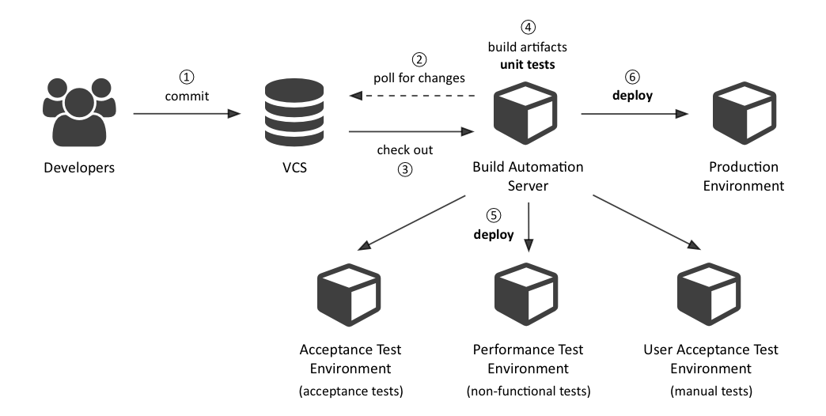
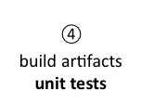
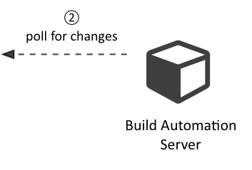
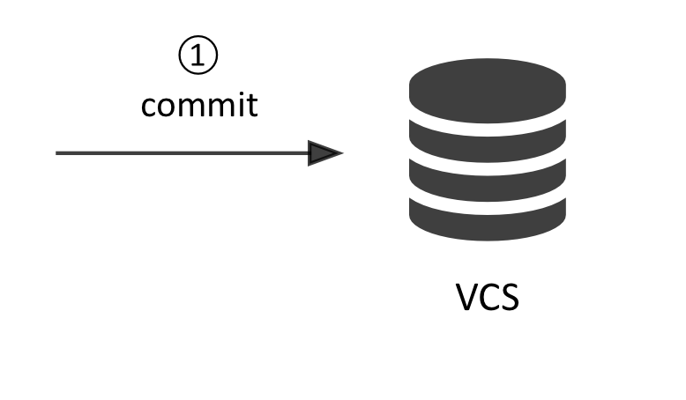
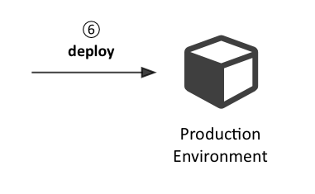

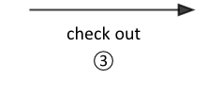
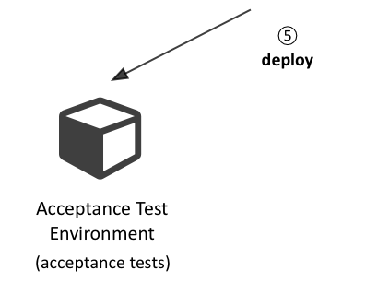
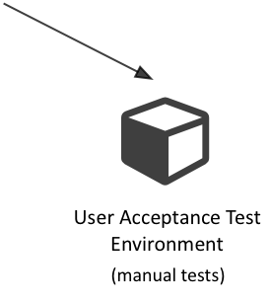
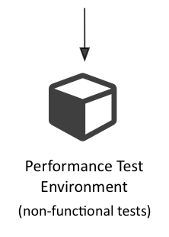
Continuous Delivery Build Pipeline
✔
✔
✔
✔
✔

Slide 21
TODO
Add Slides on
Automated Testing
Automated Deployments

Slide 22
Deployment Automation Solutions: Agent-based vs. Agentless
Notes:
There are a variety of deployment automation tools out there. But how to choose a deployment solution that is right for you? Maybe a differentiation between agent-based vs. agentless architectures can help you make a decision.

Slide 23
Agent-Based Solutions

Slide 24
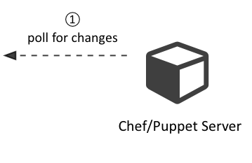
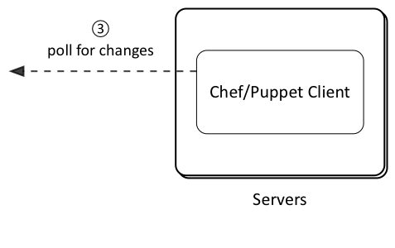
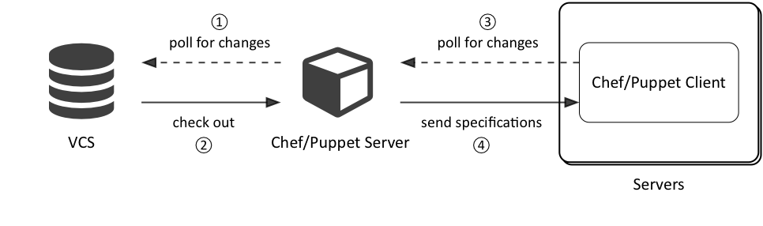
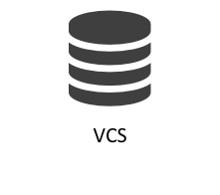
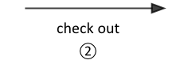
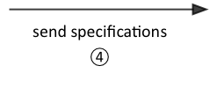
Agent-Based Deployments (Chef, Puppet)
Notes:
Note: terms “agent” and “client” are used interchangeably

Slide 25
Agent-Based Deployments (Chef, Puppet)
Can be used in client-server or client-only modes
Client must be installed on each host to be provisioned
Clients have dependencies: Ruby

Slide 26
Agentless Solutions

Slide 27
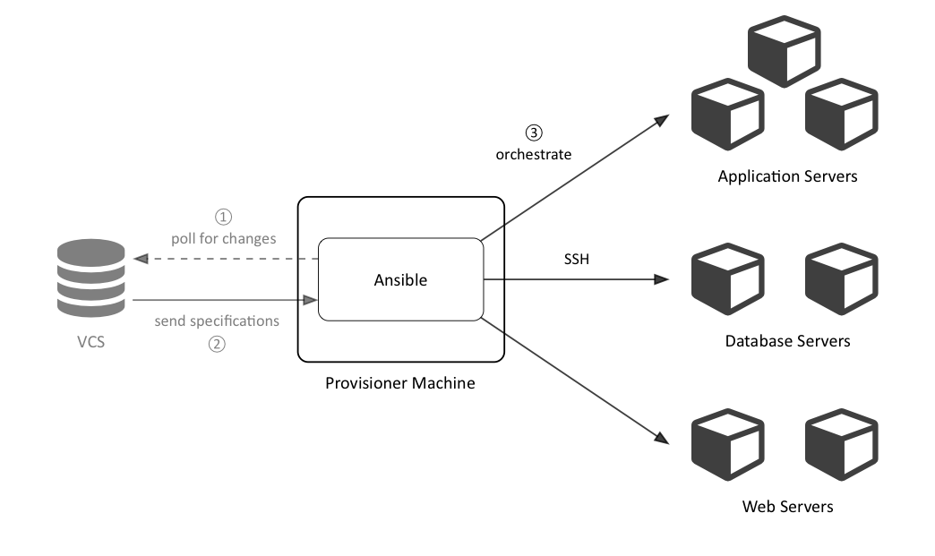
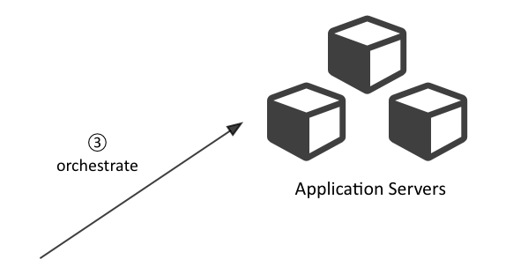
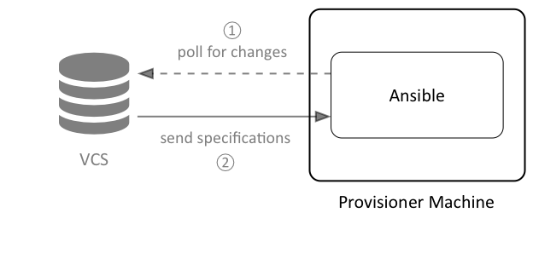
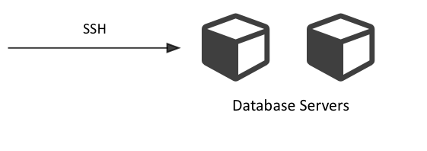
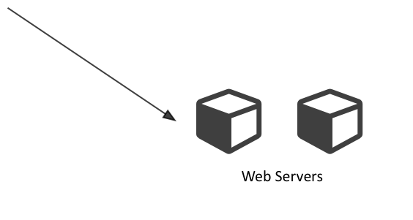
Agentless Deployments (Ansible)

Slide 28
Agentless Deployments
Ansible
Written and extensible (Python)
Human- and machine-readable configuration (YAML)
No boot-strapping required on deployment hosts (SSH)
Simple, easy to ramp up with (think of new employees!)
Clear and concise documentation

Slide 29

Use Case: Deploy Dynatrace Agents
Apache
Apache Tomcat
Apache Tomcat
PostgreSQL




Web Server
Frontend
Application Server
Backend
Application Server
Database
Git
Jenkins


check out
deploy
VCS
Build Automation

Slide 30
Ansible Concepts: Inventories
Ansible provisions groups of servers at once
Groups and hosts are stored in inventory files
An inventory file is expressed in a simple INI format

Slide 31
Ansible Concepts: Inventories
Group
 | [frontends] frontend.example.com [backends] backend.example.com [frontends:vars] dt_agent_name=frontend [backends:vars] dt_agent_name=backend
Host
Group
Variables
Variable

Slide 32
Ansible Concepts: Playbooks
--- # appservers.yml - hosts: frontends:backends vars_files: - variables.yml handlers: - name: restart tomcat service: name=tomcat state=restarted tasks: - name: Inject dynaTrace Java agent into Apache Tomcat template: > src=templates/tomcat-setenv.sh dest={{ tomcat_home }}/bin/setenv.sh notify: restart tomcat remote_user: deploy sudo: yes
Notes:
ad “play”: A play maps a group of hosts to a set of tasks

Slide 33
Ansible Concepts: Playbooks
# templates/tomcat-setenv.sh CATALINA_OPTS="$CATALINA_OPTS \ -agentpath:{{ dt_agent_dir }}/libdtagent.so =name={{ dt_agent_name }},collector={{ dt_collector_url }}"

